Slide 1

Materials in a High Temperature Service Environment
Professor John H. Perepezko
University of Wisconsin-Madison
Department of Materials Science and Engineering
1509 University Ave.
Madison, WI 53706
Materials for Harsh Service Conditions Workshop
November 19-20, 2015, Westin Convention Center Hotel
Pittsburgh, PA
Advanced Manufacturing Office

Slide 2
Challenges for Materials Performance in a Harsh High Temperature
Service Environment
Temperature range
1) 1200-1850 F (648-1010 C) – Current/Near Term
2) >1850 F—Longer Term
Environmental/Service Degradation
Oxidation – Isothermal; Thermal Cycling
Hot Corrosion (fuel impurities)
CMAS (Sand, Ash)
Steam
Creep Rupture/Fatigue
Wear/ Erosion
Phase Stability – Long Term
Microstructural Stability- Long Term
Long Term life prediction

Slide 3
Applications
Transportation
Fossil Fuel
Nuclear
Solarthermal
Geothermal
Manufacturing
Scale up – Lab Scale→Commercial
Low Cost
Low Density
Performance Diagnostics-In-Situ Sensors
Sustainability
Environmental
Recycle
Materials Availability

Slide 4
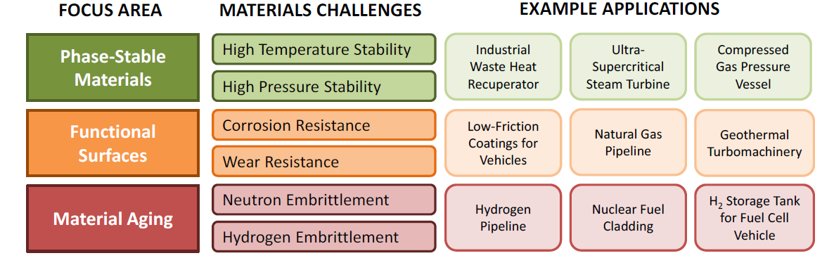

Slide 5
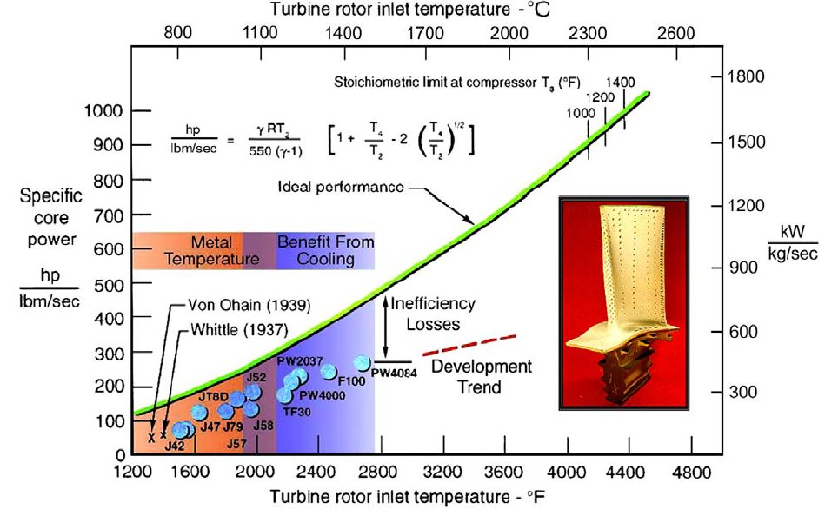
The Hotter The Better

Slide 7
Materials Options

Slide 8
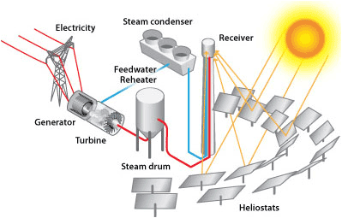
Solarthermal Reactors require high temperatures for power generation and chemical
reactions. Several key components require new materials to achieve potential.

Slide 9
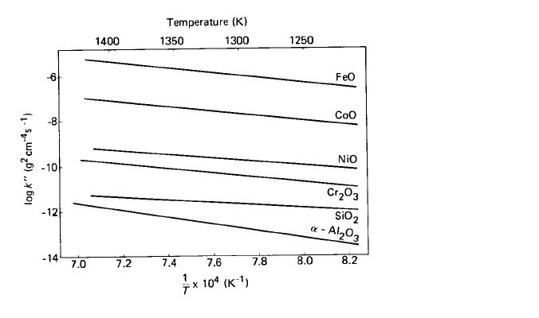
Functional Coating Design – Environmental Resistance
1-TBC/EBC
2-Oxidation Resistant
3-Compatibility (Bond Coat)
4-Reservoir/Diffusion Barrier
Substrate
Layers/Substrate mechanical compatibility
Layers/Substrate thermodynamic compatibility
At ultrahigh temperature silica is favored
over alumina.

Slide 10
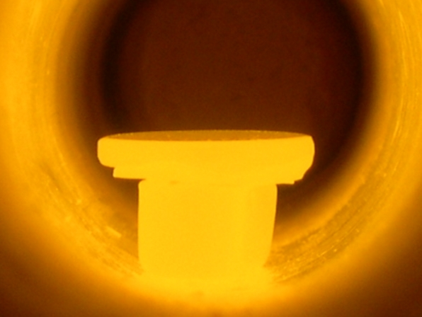
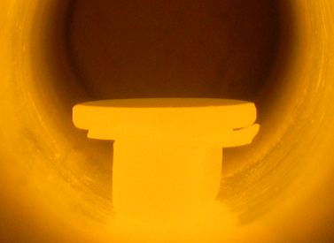
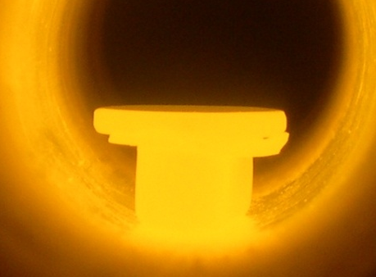
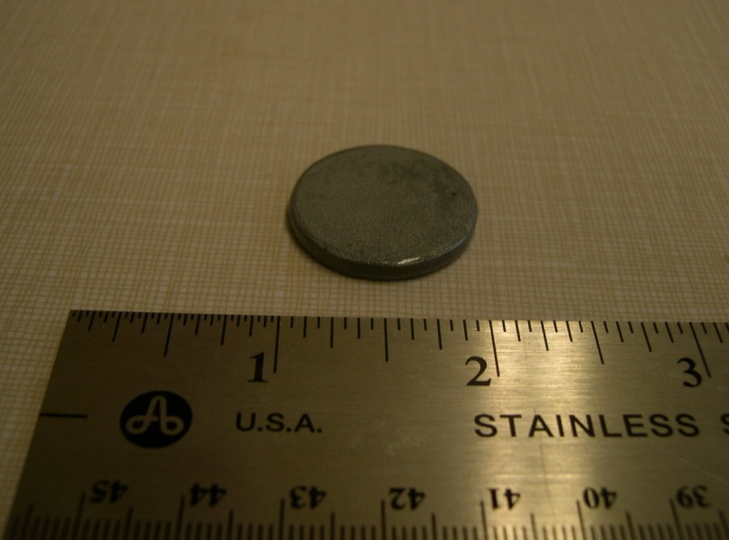
Progress-Mo-Si-B Coated Pure Molybdenum
Oxidized in Air at 1700ºC/3092ºF
1700ºC / 2 hrs
1700ºC / 12 hrs
1700ºC / 25 hrs
Mass Change:
+ 1.7 mg/cm² (1700ºC /25hrs)

Slide 11
The Path Forward - Materials Challenges/Strategies
Incremental (1200-1850F)
Ultrahigh Strength Steels (Alumina Former)
ODS—Manufacturing Scaleup
Austenitic with intermetallics—Phase Stability
Functional Coatings
Semi-Empirical to Guided Design- Thermodynamic (Calphad); Mechanical
Application Methods- Commercial Scale
Amorphous/Nanocrystalline Wear/Corrosion
Environmental Barrier Coatings, EBC (Silica)
Longer Term – Ultrahigh Temperature (>1850F)- High Payoff
Refractory Metal (Mo, Nb)Alloys (Mechanical, Silica Former)
Ceramic Composites – SiC/SiC (EBC, Processing)
Advanced Coating Capability

